Slide 1


TOP 500 Movie API EXPLORER
Created by:
Alvin - Thanh Vinh Giang
Frank - Hao Nguyen
Uth - Uthpalie Thilakaratna
Tam - Tammy Powell
Are you looking for a movie to watch?
Are you wondering what are the top 500 movies from the last 5 years?
Are you wondering what are the top 10 foreign language movies?
STEP INSIDE OUR DATABASE

Slide 2





Our Source
URL: https://developer.themoviedb.org/reference/discover-movie
ETL
Extracting Data
Data Organising / Transforming
Data Loading
Why SQL
FLASK API & our additional unknown library
Our additional unknown Library

Slide 3

















Slide 4
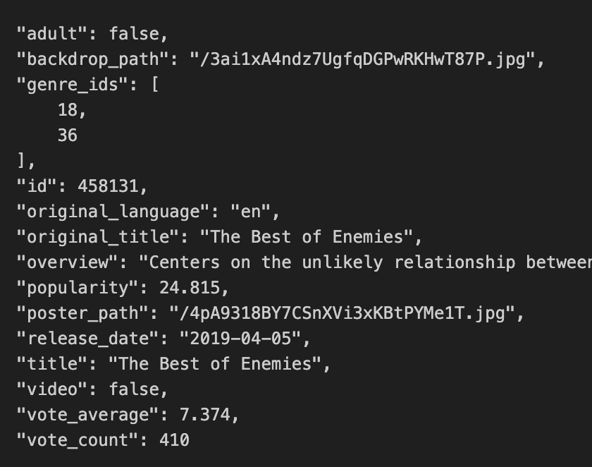
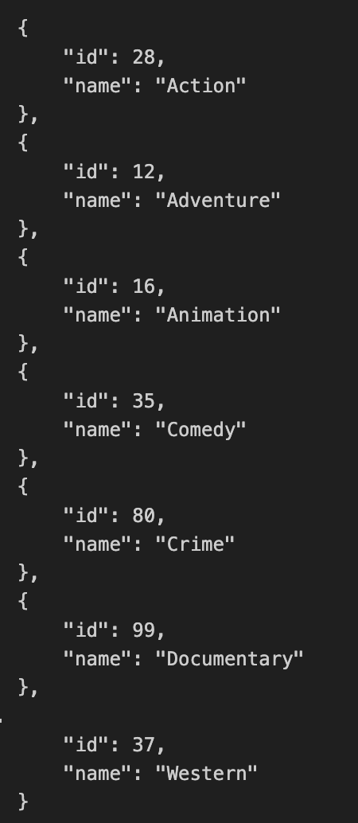
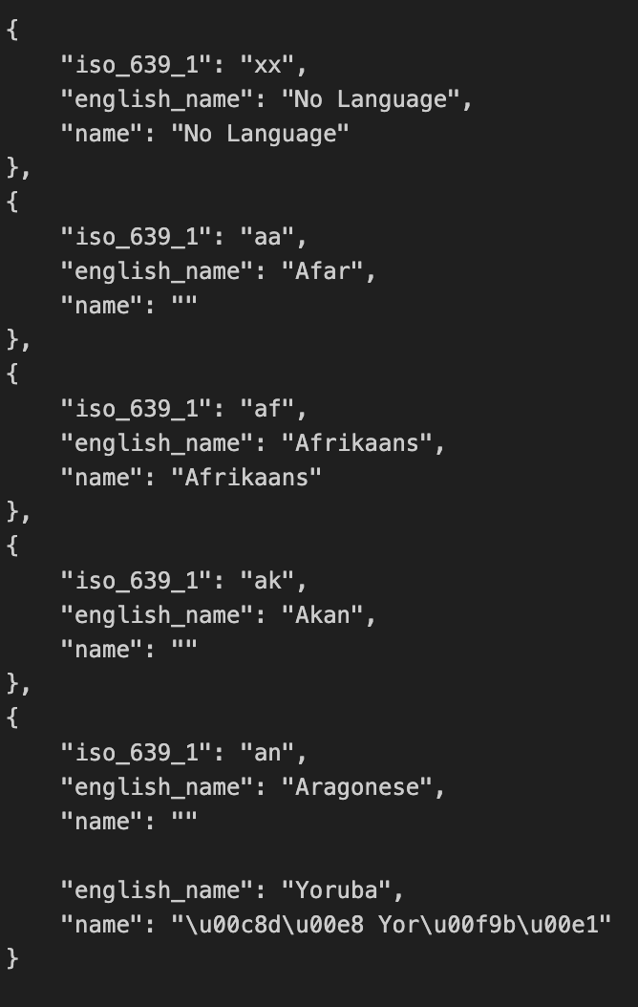
Extracting
3 API Endpoints
Movies
Genres
Languages

Slide 5
Transforming
Removing duplicate data
Data Cleaning
Correcting errors
Dropping unnecessary columns
Data Structuring
Renaming and reorganising columns

Slide 6
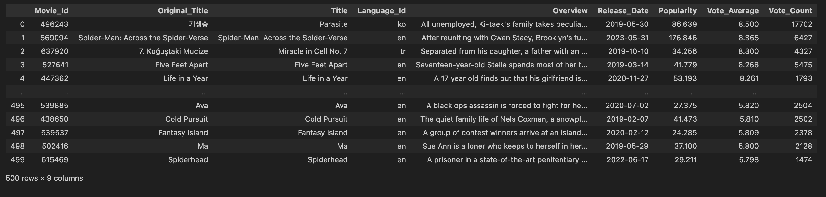
Transforming
Data Filtering
Movies have more than 1000 votes
Data Sorting
Sort by Vote Average in descending order

Slide 7
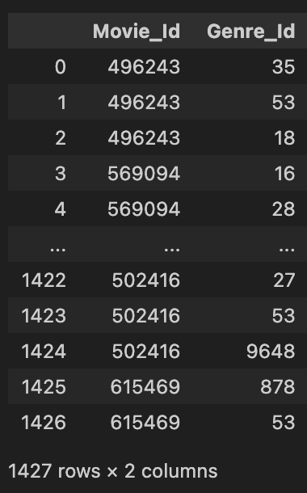
Transforming
Movies & Genres: Many to Many Relationship
Data Integration
Junction Table: Movie Genre Table
Primary key: Composite of Movie_ID and Genre_ID

Slide 8
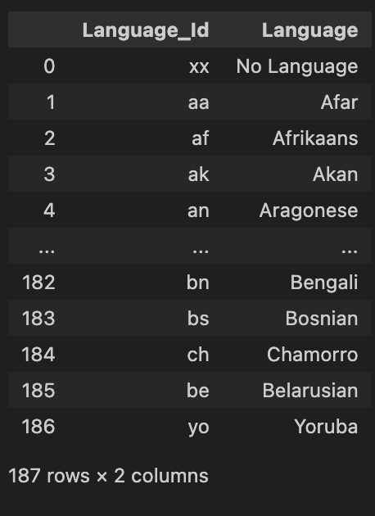
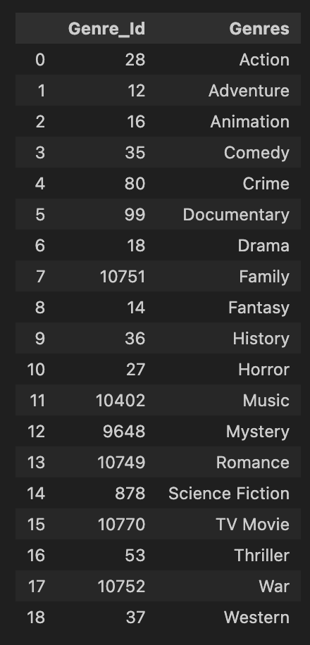
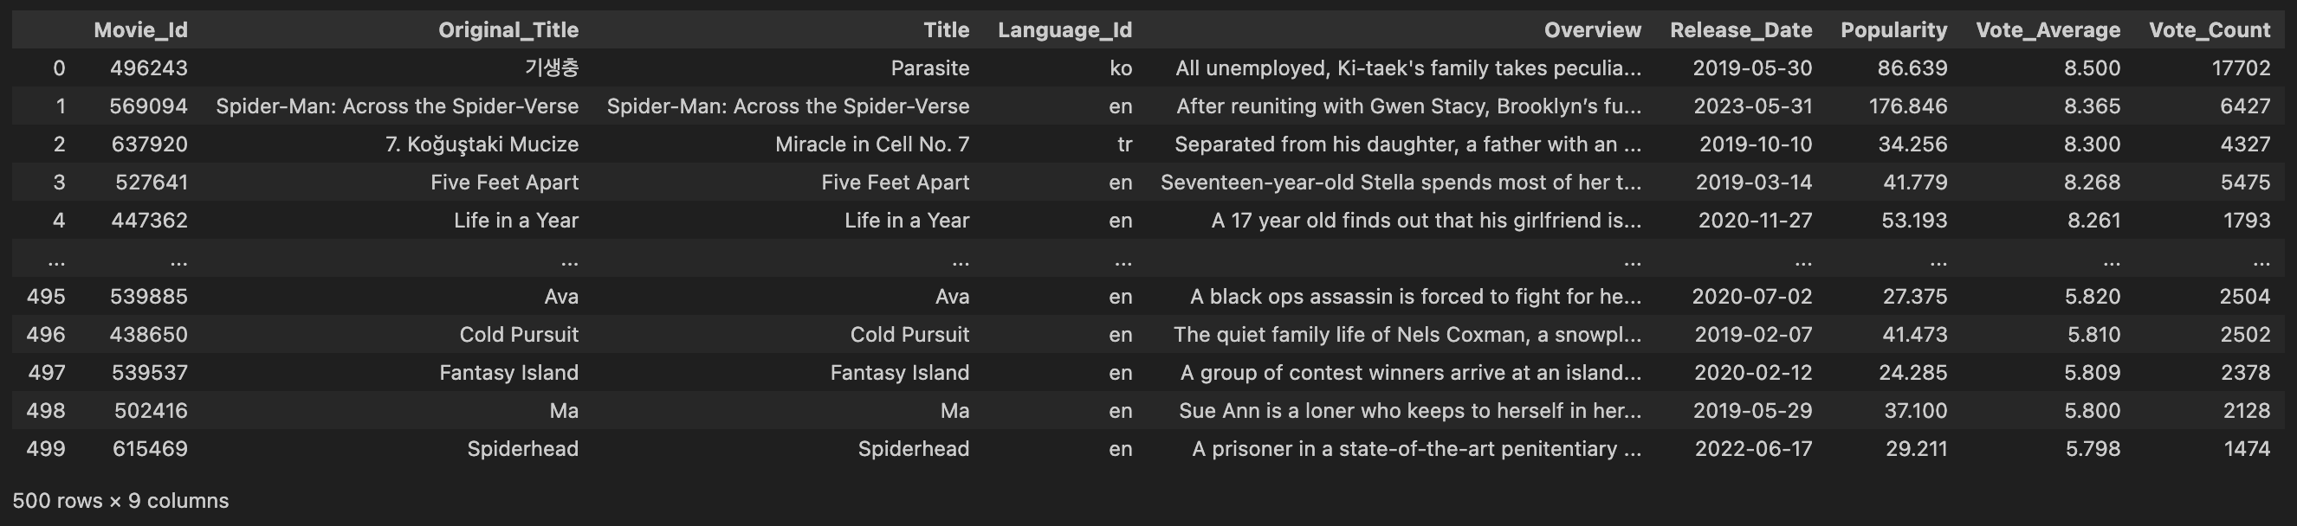
Languages
Data frame
Genre
Data frame
Movie Genre
Data frame
Movie
Data frame

Slide 9
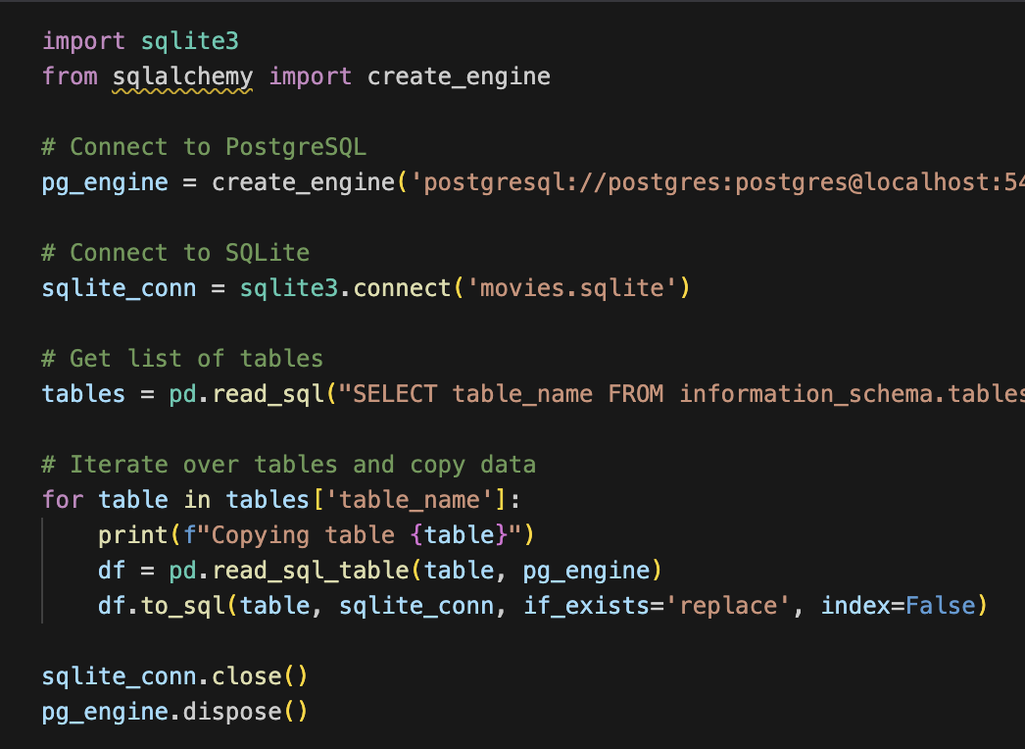
Loading
Create table Schemas
Import csv files
CSV files
PostgreSQL
Data frames
SQLite database file

Slide 10
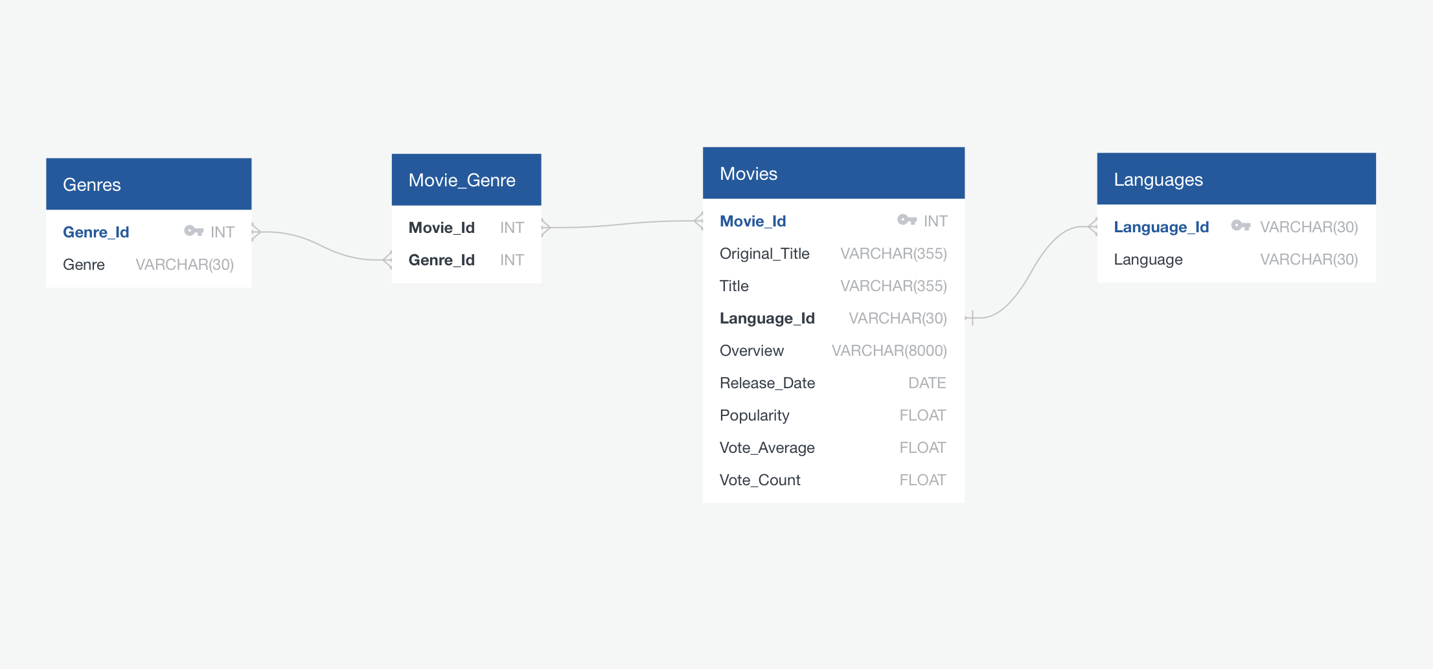
ERD Diagram
Page Number 9
Notes:
"This ERD diagram shows the relationships between the 'Movies', 'Genres', and 'Languages' tables. The 'Movies' table is central, connected to 'Genres' through the 'Movie_Genre' associative table and to 'Languages' through a direct relationship. Each movie can belong to multiple genres and be associated with a specific language, providing a comprehensive way to organize movie data."

Slide 11
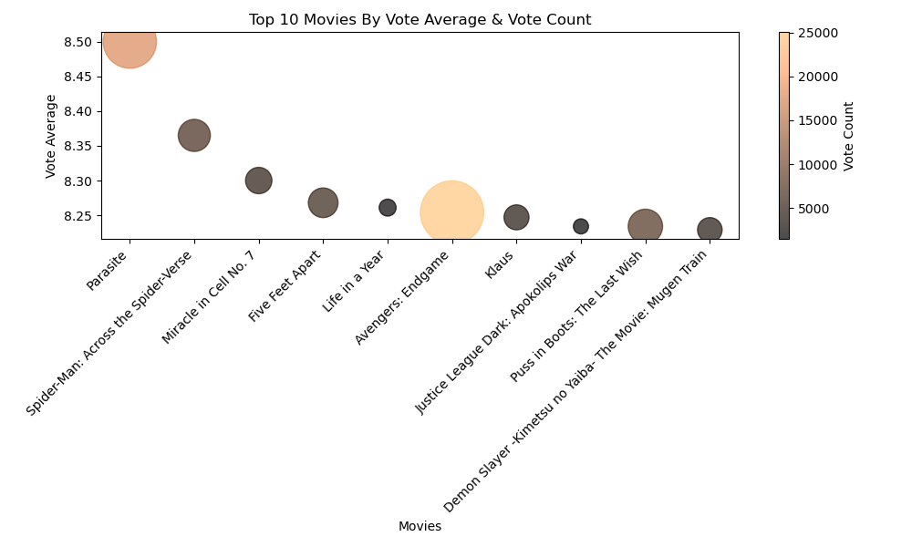


Highest Vote Average:
'Parasite' has the highest vote average (~8.5).
Highest Vote Count:
'Avengers: Endgame' has the highest vote count (~25,000 votes).
Comparison:
Note the balance between quantity (vote count) and quality (vote average)
Insights:
Popular movies (high vote count) don't always have the highest ratings.
Page Number 10
Notes:
"Here's a scatterplot representing the top 10 movies by vote average and vote count. On the x-axis, we have the movie titles, and on the y-axis, their average vote ratings. The size of the bubbles indicates the vote count, with larger bubbles representing more votes. Firstly, 'Parasite' stands out with the highest vote average, slightly above 8.5, and a substantial vote count. 'Avengers: Endgame' is notable for its very high vote count, around 25,000, although its vote average is slightly lower at about 8.3.Movies like 'Spider-Man: Across the Spider-Verse' and 'Justice League Dark: Apokolips War' also have high vote averages, indicating strong audience appreciation. This plot effectively shows how popular movies don't always have the highest average ratings, highlighting the balance between quantity and quality in audience votes."

Slide 12
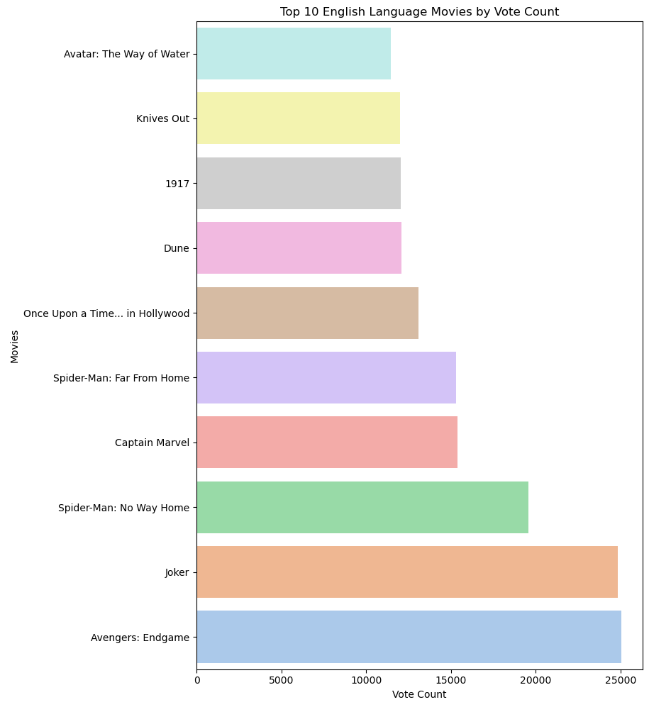

Popularity Indicators:
High vote count reflects strong audience engagement and popularity.
Highest Vote Count:
Avengers: Endgame' (~25,000 votes).
Genre Diversity:
Includes superhero films, thrillers, and historical dramas, reflecting varied audience preferences.
Notes:
"Here we have a bar chart showcasing the top 10 English language movies by vote count. The movies are listed on the y-axis, and the vote count is on the x-axis.
'Avengers: Endgame' leads with the highest vote count, nearing 25,000 votes, followed by 'Joker' and 'Spider-Man: No Way Home', both with substantial vote counts around 20,000. Other notable entries include 'Spider-Man: Far From Home', 'Captain Marvel', and 'Once Upon a Time... in Hollywood'.
Interestingly, 'Avatar: The Way of Water' and 'Knives Out' have the lowest vote counts among the top 10, despite being popular films. This chart provides a clear visual of the popularity and audience engagement with these movies."

Slide 13
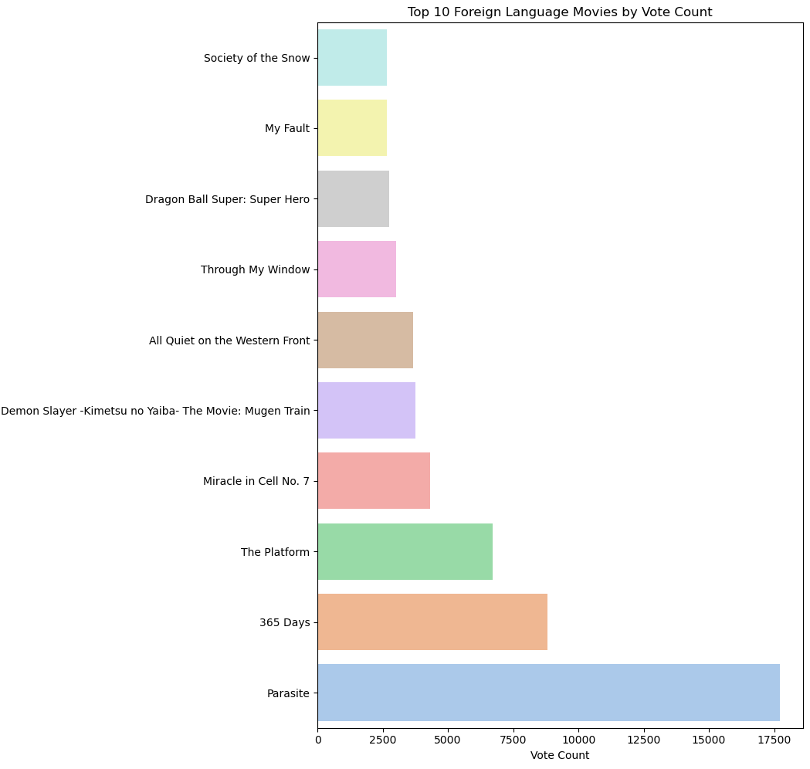

Genre Diversity:
Includes thrillers, romances, science fiction, anime and dramas, reflecting varied audience preferences.
Cultural Representation:
Represents diverse cultures and perspectives, enriching storytelling and promoting cultural understanding and appreciation.
Award Recognition:
Acknowledged with prestigious awards and nominations, affirming its impact and contribution to the film industry.
Notes:
"Let's take a look at the top 10 foreign language movies by vote count. Leading the list is 'Parasite' with nearly 17,000 votes, showcasing its global appeal. '365 Days,' a hot topic in Poland, follows with 8,500 votes. 'The Platform,' a thought-provoking Spanish thriller, also grabs attention with 7,000 votes. Other fan favorites include 'Miracle in Cell No. 7,' 'Demon Slayer: Mugen Train,' and 'All Quiet on the Western Front.' These films highlight the diverse storytelling and wide-reaching impact of international cinema."

Slide 14

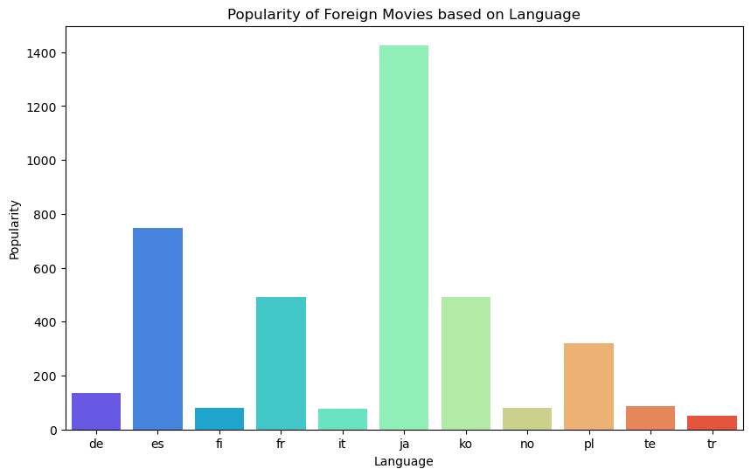
Diverse Genres:
Foreign films offer a wide range of genres and storytelling techniques, enriching the global film landscape.
Awards and Recognition:
Many foreign films have received international awards, increasing their popularity and visibility.
Streaming Services:
Platforms like Netflix and Amazon Prime have made foreign films more accessible to a global audience.
Language Codes
ja – Japanese tr – Turkish fr – French de – German
es – Spanish fi- Finnish it – Italian ko – Korean
te – Telugu no – Norwegian pl – Polish
Notes:
I'd like to share some insights into the popularity of foreign movies based on the languages they are produced in, showcasing the global diversity in cinema."
"Japanese films lead the chart with over 1400 points. This shows the strong global appeal and significant cultural impact of Japanese cinema.
Spanish films come in second with around 800 points. The influence of Spanish-language films is notable and continues to grow internationally.
French movies follow with about 500 points, reflecting their rich cinematic tradition and widespread popularity.
Korean films, with approximately 600 points, have also gained considerable success and a strong international following.
Additionally, films in languages like German, Italian, Norwegian, Polish, Telugu, and Turkish contribute significantly to the global film landscape, showcasing a variety of cultural narratives.“ This highlights the cultural exchange through cinema and how foreign films contribute to a better understanding of global narratives and perspectives.

Slide 15
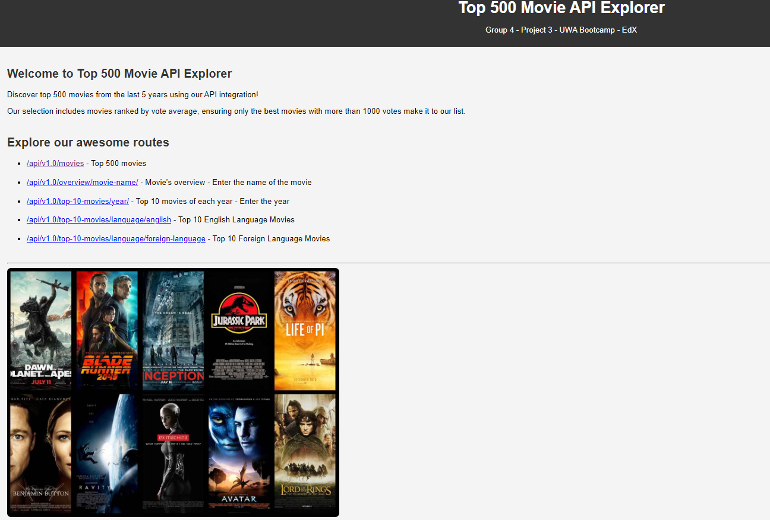
Flask API
Page Number 8

Slide 16







SUMMARY
We used The Movie Database (TMDB) API to obtain data of movies from 2019-2024. We ensured the data used were ethically sources; data that was only publicly available and movies that were not rated ‘adult’.
The data was put through ETL process to obtain 500 dataset based on the criteria for the project, using Python and Pandas. Datasets were converted to CSV files.
The SQL database was created in Postgres and data CSV files imported.
The database architecture is shown with an ER diagram.
The data was retrieved for Data Visualization using Seaborn, a new Python library.
Using Flask API with JSON output, the data was displayed for users including interactivity.

Slide 17


